Slide 1
NOTEMAKING

Slide 2
How to Write Notes
Note Making is a process of writing down important details from a source.
It helps to go through a lot of information in less time.
There are two formats in which one can write notes. They are
Linear Note Making, and
Non-Linear Note Making

Slide 3
LINEAR NOTE MAKING
Notes presented here is in a very structured manner i.e., one line after the other.
Here, a person writes a note in the form heading, subheading, and points. It also includes keywords, indention, and abbreviations.

Slide 4
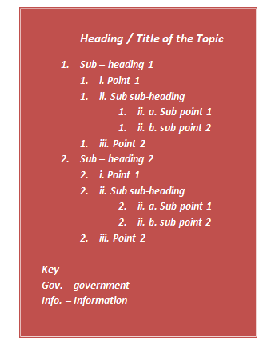

FORMAT OF LINEAR NOTE MAKING

Slide 5
HEADING
The heading should be very clear and brief in order to have a clear idea of the notes made. It gives the main idea of the passage.
SUBHEADING
subheading is a subdivision of the main topic. One can use as many subheadings as he or she wants.
POINTS
Below subheading, there are some points which are the part of the main topics.

Slide 6
SUBSUBHEADING
One can add more headings below the points for showing the category, types, advantages, etc.
INDENTATION
proper alignment and spacing in the written matter. It indicates the subheadings, points, sub-points, sub-subheadings, etc. clearly. Indentation offers a well-defined structure for a note.
Codes, symbols or the abbreviation for the clear understanding in the note making format.
KEY

Slide 7
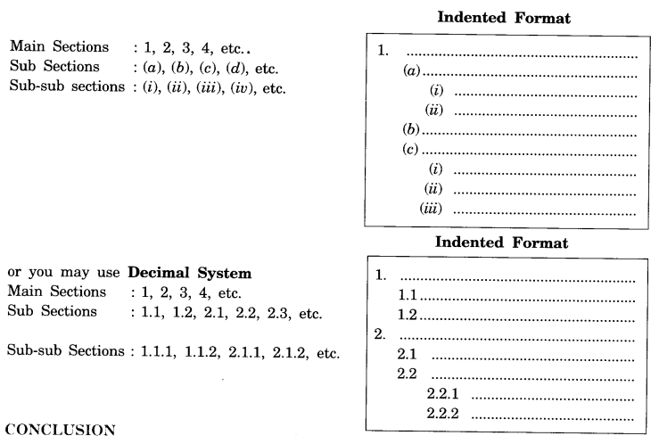

Slide 8
Abbreviations Using the beginnings of words Max. – Maximum Min. – Minimum Using the beginnings of words with the last letter Dept. – department Govt. – government Prblm. – Problem Schl. – school Using the first and the last letter of a word Mt – mount | Symbols = @ % & + - i.e., ETC | Acronyms CBSE CM UNICEF WHO DOB HR CEO USA UK

Slide 9
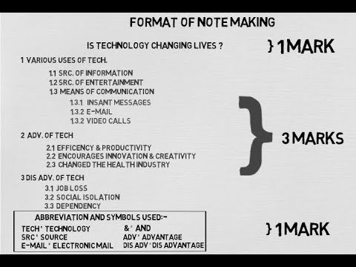

Slide 10
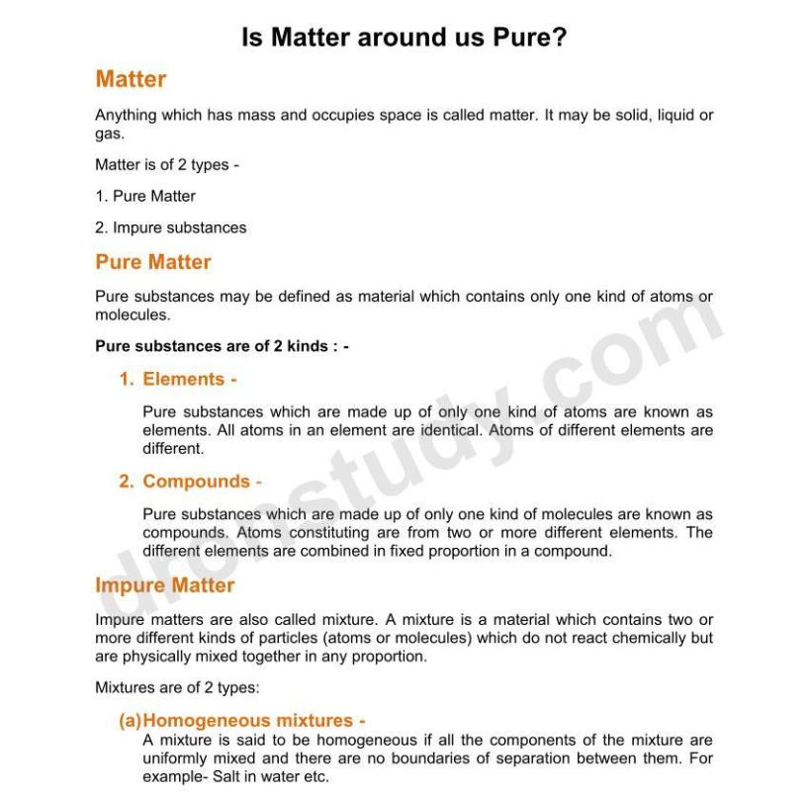

Slide 11
DO’S AND DON’T’S OF NOTEMAKING
Keep your note-organization simple
Write in your own words.
Write in short
Capture ideas as well as facts.
Skip lines; leave space between main ideas
Develop your own abbreviations and symbols. (Not too many, but enough.)
Don't - Write Everything
DON’T USE COMPLETE SENTENCES
Don’t over-indent.
Avoid using Roman numerals
Avoid too many abbreviations. (Causes trouble deciphering later.)

Slide 12
POINTS TO REMEMBER
• Indent the notes properly
• Use of abbreviations
• Heading / Title should be 3 – 4 words
• Sub heading should be 3-4 words
• Key at the end of the note should be enclosed with a box
• Don’t include all the information present in an article or paragraph.
• There should be no grammatically correct sentences in the notes.

